Slide 1

PROJECT presentation
Classification of Breast Cancer using Machine Learning
16.12.2021

Slide 2

SIDHO-KANHO-BIRSHA-UNIVERSITY
DEVELOPED BY:
MOU MAJHI
GUIDED BY:
Prof Anisha Mahato
Prof Joy Gorai
Computer Science Department
S.K.B.U Purulia
HEAD OF DEPARTMENT:
Dr. Sanat Mahato
Computer Science Department
S.K.B.U Purulia

Slide 3

01
Project introduction
02
Obejctive
03
Why Machine Learning
04
Requirements
contents
05
Dataset
06
M ML Algorithms Algorith
07
Methodology
08
Working Progress
09
Conclusion
10
Future Use Algorith

Slide 4
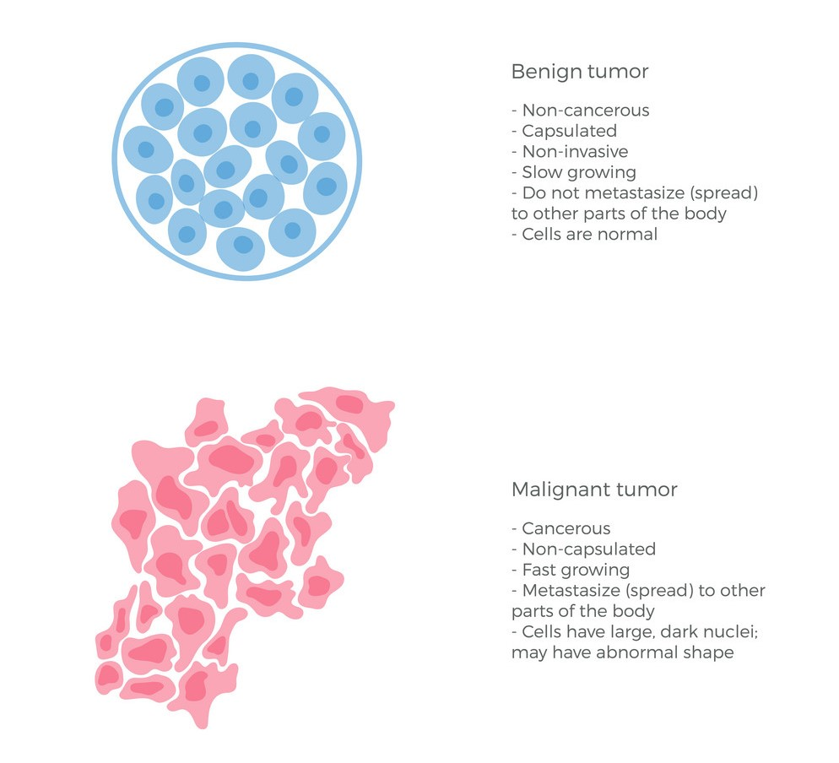
Introduction
Types of Tumors:
Benign Tumors
Malignant Tumor

Slide 5
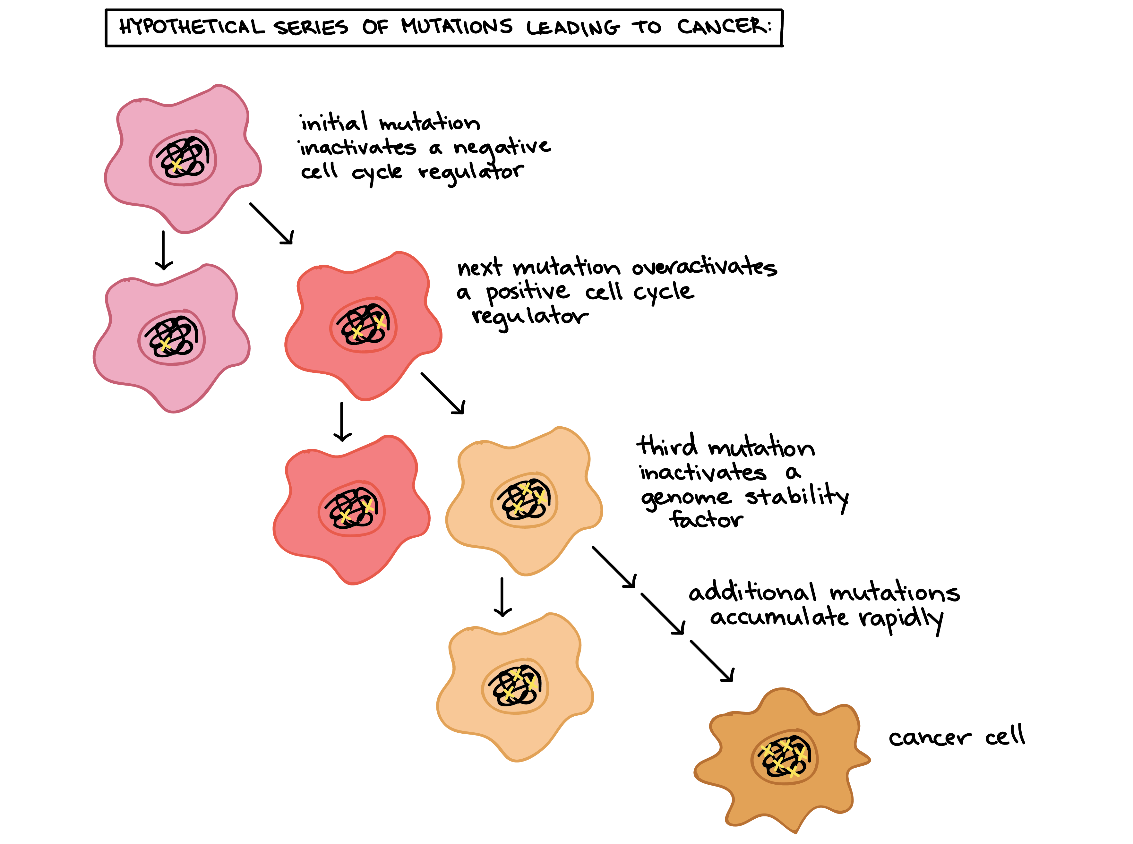
Introduction
What is Breast Cancer?
Cancer is a disease in which mutations allow the cells to divide and multiply in a very uncontrolled and chaotic manner.
The cancer that develops in the breast cells is called breast cancer.

Slide 6
Objective
Dataset
Reduces Cases
There are around 2000+ new cases of breast cancer in men each year, and about 2,30,000 new cases in women every year. .
It is done by taking the patient’s data and mapping it with the dataset and checking whether there are any patterns found with the data. .
Accuracy
Less Expensive
This provide high accuracy and Precision..
It reduces the amount of money they need to spend just for the diagnosis..
Less Tests
Time Saving
This helps save a lot of time .
If a patient has breast cancer, then instead of taking more tests to check whether the cancer is malignant or not

Slide 7
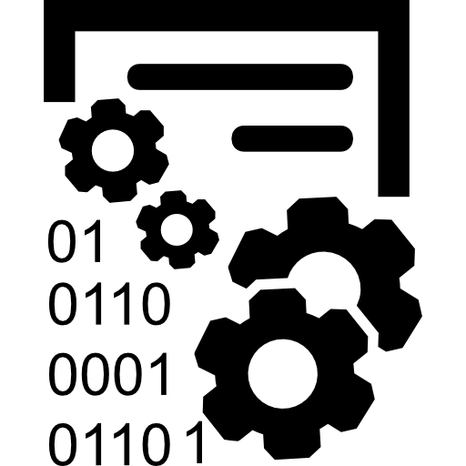
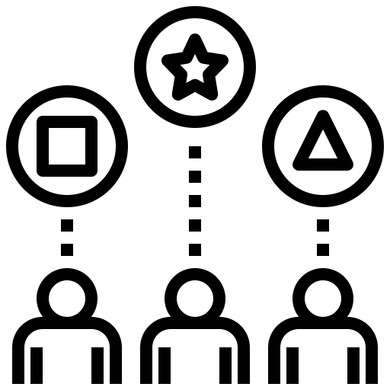




How MACHINE LEARNING Plays an Important Role Here:
Automatically learn and understand data from experience without Explicit Programmed
Dataset
Split data
Study the
problem
Discover and identify patterns and relationships
Traditionally,Breast ultrasound,
Mammogram was used.
Evaluate
Solution
Train ML Algo
Proposed system take the patient’s data and mapping it with the dataset
Analyze
Errors

Slide 8
Requirements
HARDWARE REQUIREMENTS
SOFTWARE REQUIREMENTS
Processor : Any Processor above 500 MHz
RAM : 512Mb
Hard Disk : 10 GB
Input device : Standard Keyboard and Mouse
• Operating system: Windows 10 • Microsoft Excel • Anaconda with Python3 • Spyder • Jupyter Notebook • Scikit-learn library

Slide 9
Dataset:
The Wisconsin Diagnostic Breast Cancer (WDBC) dataset which can be found in University of California, Irvin’s Machine Learning Dataset Repository will be used for this project.
The dataset contains these features:
•compactness
•concavity
•concave points
•symmetry
•fractal dimension
•radius
•texture
•perimeter
•area
•smoothness
Each of these features have information on mean, standard error, and “worst” or largest computed.

Slide 10
ML Algorithms:
LOGISTIC REGRESSION
NAÏVE BAYES
K-NEAREST NEIGHBOUR
FOREST AND TREE METHODS
SUPPORT VECTOR MACHINE

Slide 11
Methodology Followed :
The steps followed to do this project are:
1. Collection of dataset.
2. Understanding features of dataset.
3. Pre-processing the data
. 4. Split data into training dataset and testing dataset.
5.Apply ML algorithms to dataset to predict the breast cancer.
6.Improving results

Slide 12
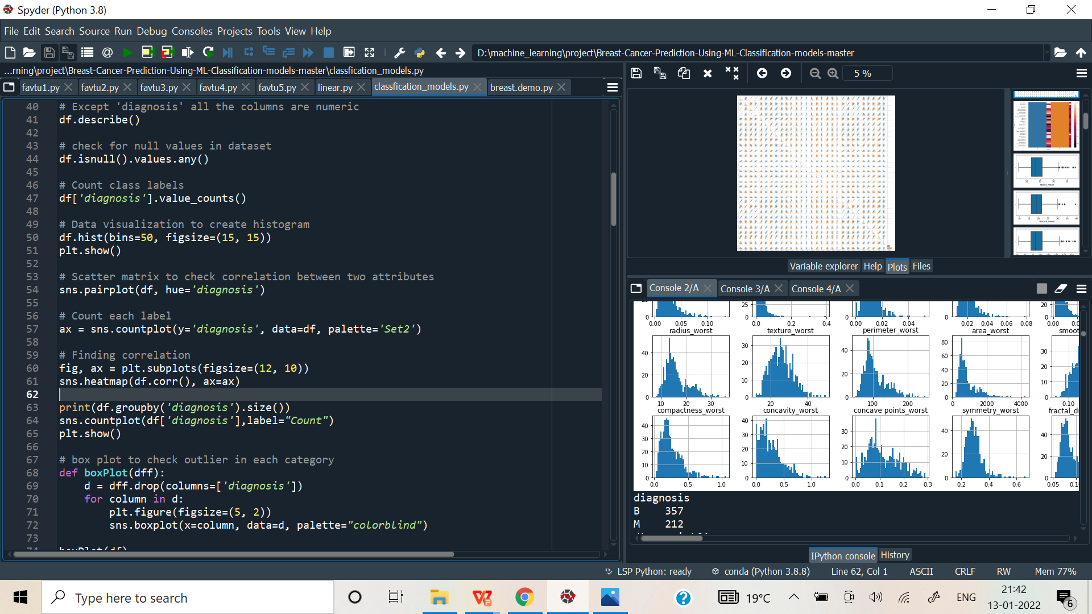
Working Progress Snapshot :

Slide 13
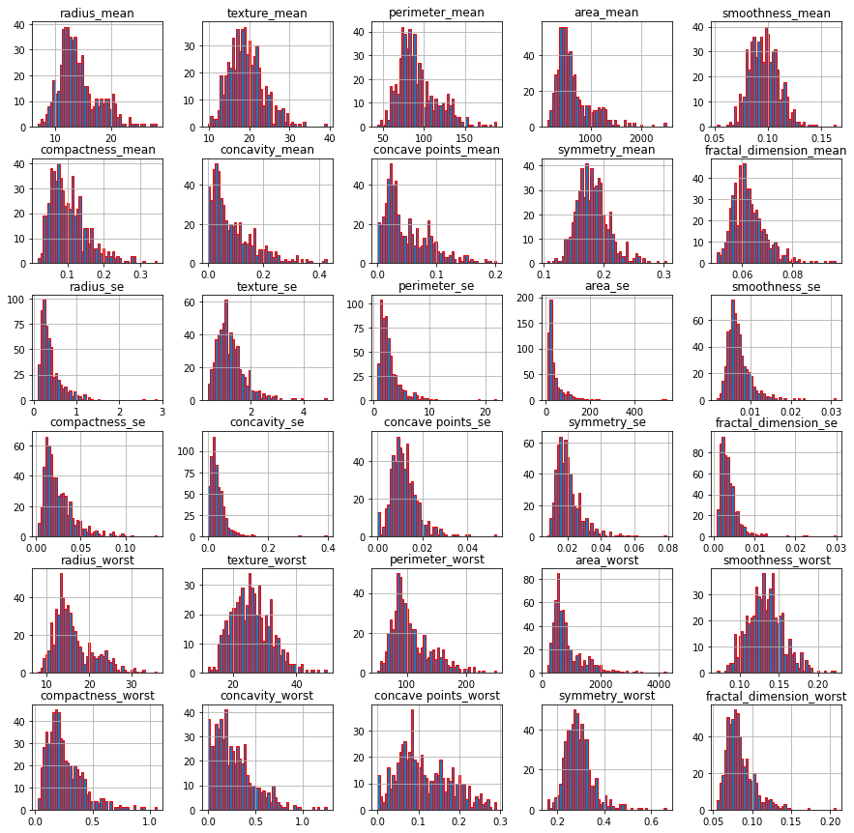
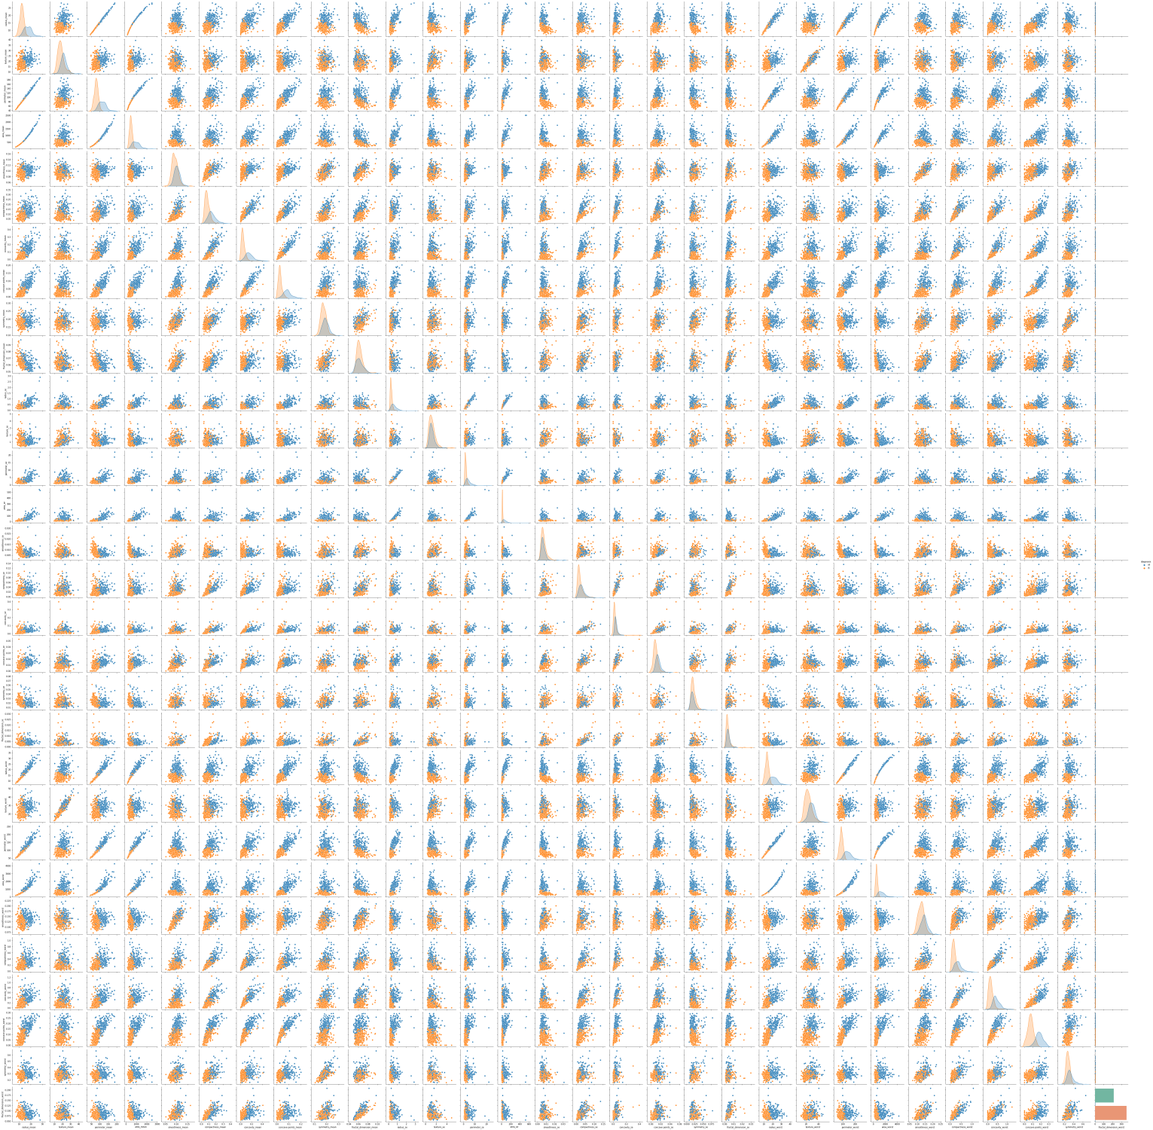
Working Snapshot :
Hist pyplot
Scatter pyplot

Slide 14
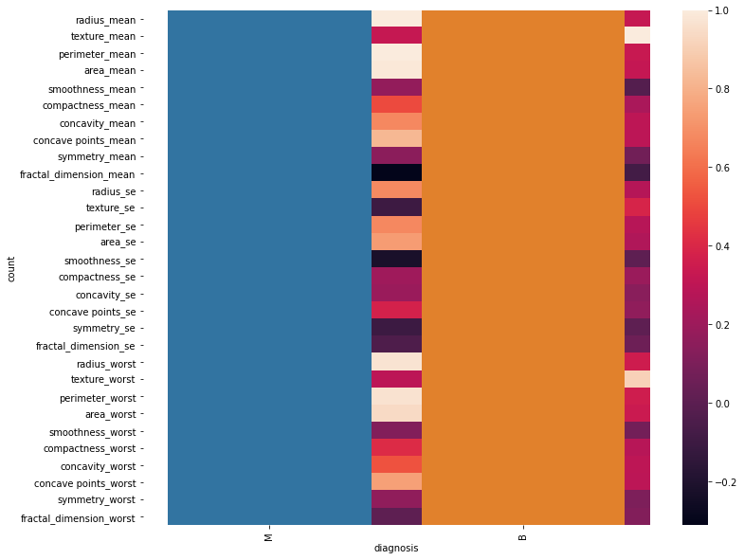
Working Snapshot :

Slide 15
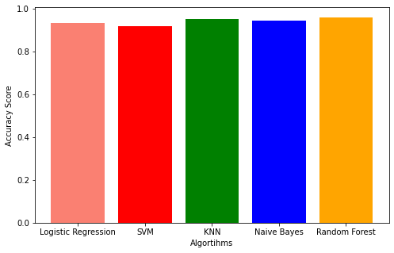
Working Snapshot :
Accuracy bar Graph

Slide 16
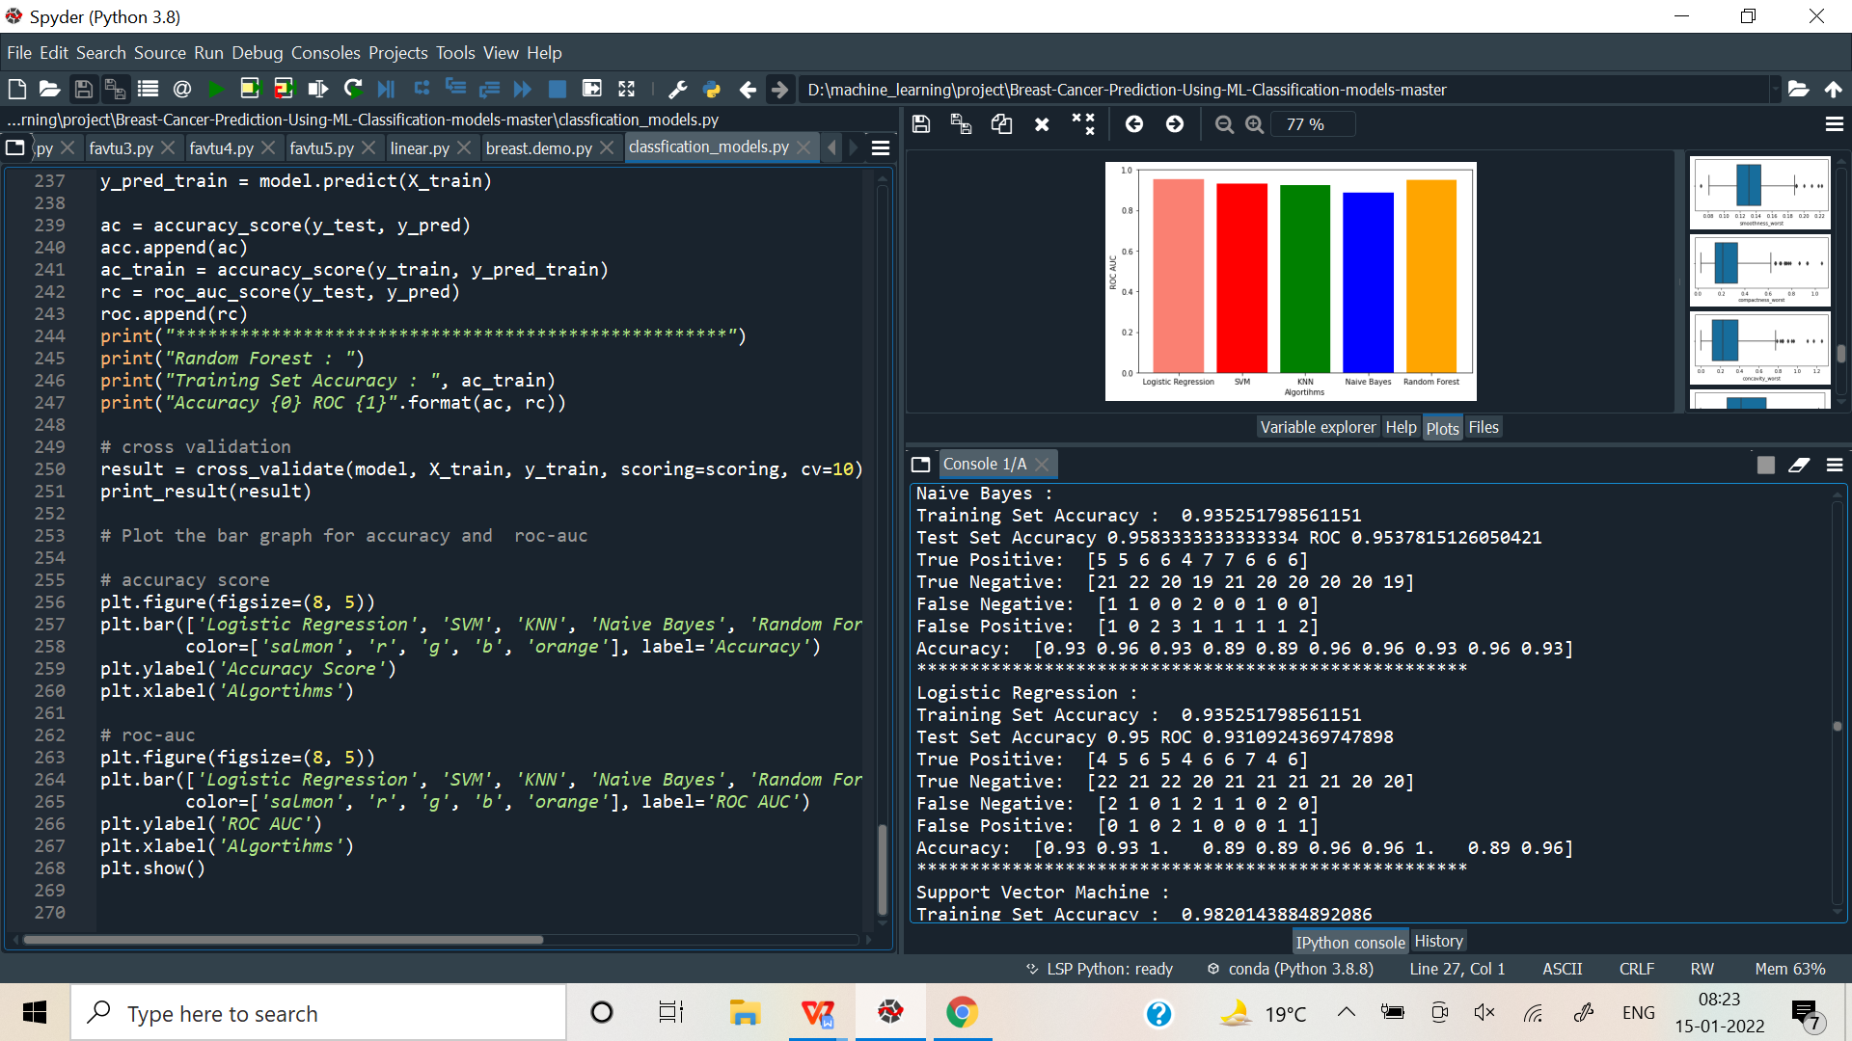
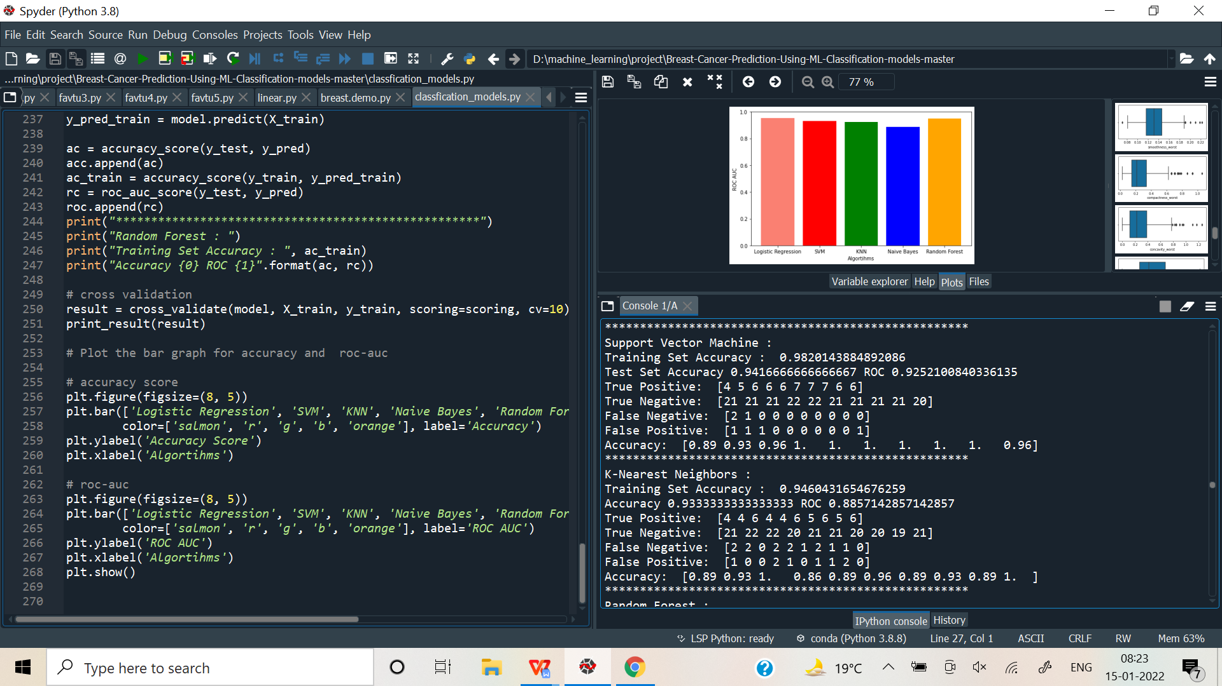
Working Snapshot :

Slide 17
Conclusion:
Breast cancer is a serious threat to women throughout the world and is responsible for increasing the female mortality rate.
Our scheme was developed to reduce the time and cost factors of the patients as well as to minimize the work of a doctor.
However, collecting good data is the most challenging part.
Although its giving accuracy around 98% , the model may sometimes predict true negative & false positive.

Slide 18
Future use:
In the future, we can also use a dataset to predict the re-occurrence
of breast cancer after a surgery or chemotherapy session.
Artificial Neural Networks can be applied to make the prediction better and smarter. Accuracy can be increased by selecting better features.

Slide 19

THANK YOU！
Any Question?

